Slide 1





NEXORA
• NEXT GENERATION OF STUDENT COLLABORATION •
Presented by Team INNOV8
1
SMART INDIA HACKATHON-2026

Slide 2
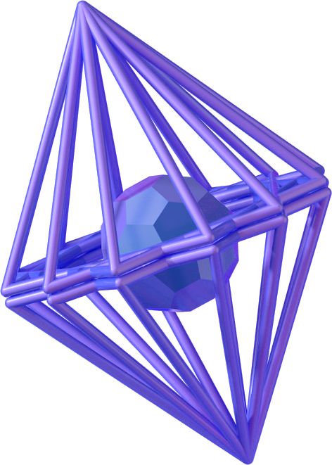


PROBLEM
STATEMENT
(Campus Talent, Skills & Project Team Formation Network)
👥 Talent Discovery Problem
📱 Reliance on Informal Channels
❌ Missed Opportunities
🧩 Difficulty finding teammates with the right skills
🎯 Talent scattered across campus
🔍 Limited visibility into student expertise
💬 WhatsApp Groups
🤝 Personal Networks
📢 Word-of-Mouth Referrals
🚀 Missed hackathon and project opportunities
🔬 Limited research collaboration
⏳ Slow and inefficient team formation
2
INNOV8

Slide 3
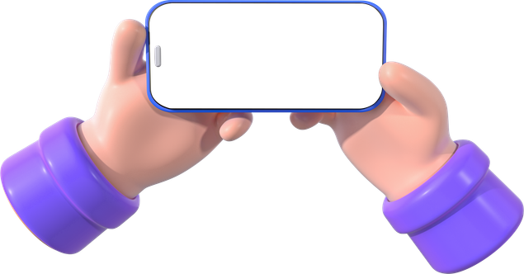

Existing Solutions and their Limitations
💬 WhatsApp Groups
✅ Easy communication
❌ Messages get lost in chats
❌ No skill-based teammate discovery
❌ Difficult to organize opportunities
🌐 Discord / Online Communities
✅ Large communities
❌Information overload
❌ No campus-specific matching
❌ Hard to find relevant collaborators
🤝 Personal Networks
✅ Trusted connections
❌ Limited to existing friend circles
❌ Hidden talent remains undiscovered
❌ Missed collaboration opportunities
3
INNOV8

Slide 4



Our Solution
👤 Student Profiles
Skills
Interests
Availability
Experience
🔬 Opportunities Hub
Projects
Research
Hackathons
A Student Talent & Team Formation Network
A unified platform that helps students discover talent, find opportunities, build teams, and collaborate effectively for hackathons, projects, and research.
🎯 Smart Matching
Talent Recommendations
Match Percentage
Personalized Suggestions
👥 Team Formation
Build Teams
Recruit Members
Missing Talent Detection
4
INNOV8

Slide 5






Platform Workflow
📝 Create Profile
(Skills, Interests, Availability)
👤 Student Login
🚀 Project / Research Execution
🎯 Smart Matching Engine
💬 Collaboration & Communication
📊 Match Score Generation
👥 Team Formation
5
INNOV8

Slide 6





Key Features
📊 Team Match Score
Generates compatibility percentages
Matches students with projects and teams
Considers skills, interests, availability, and experience
🏆 Student Portfolio
Showcase projects and achievements
Highlight certifications and research work
Build a professional student profile
🎯 Smart Matching
Recommend suitable teammates
Generate compatibility/match percentage
Suggest relevant projects and opportunities
👥 Team Formation
Create teams for projects, hackathons, and research
Recruit members based on required skills
Build balanced multidisciplinary teams
🔬 Projects & Research Hub
Discover project and research opportunities
Connect with professors and mentors
Apply for projects that match your skills
❓ Question & Discussion Forum
Ask academic and technical questions
Participate in knowledge-sharing discussions
Learn from peers, mentors, and professors
✅ Missing Talent Detection
Identify missing roles within a team
Highlight required skills not yet covered
Help complete project teams efficiently
💬 Communication Center
Direct student-to-student messaging
Team discussion channels
Student-professor communication
6
INNOV8

Slide 7

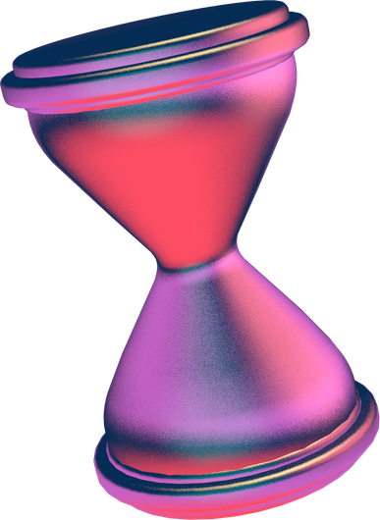
TARGET
Users
Primary
Secondary
USERS
USERS
Undergraduate students
Postgraduate students
Hackathon participants
Students seeking project teammates
Students interested in research oppportunities
Professors and research mentors
Club representatives
Student organization leaders
7
INNOV8

Slide 8
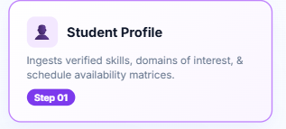
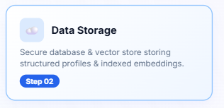
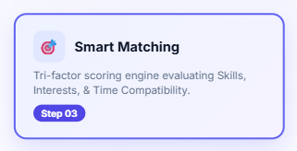
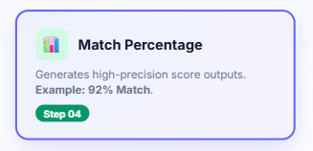
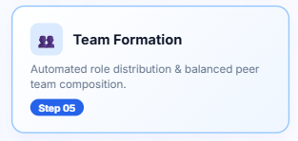

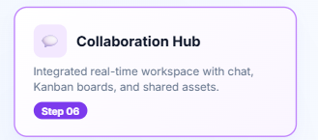
Technical Approach
Technology Stack
🎨 Frontend
• React.js
• HTML, CSS, JavaScript
⚙️ Backend
• Node.js
• Express.js
☁️ Database
• Firebase Firestore / MongoDB
🔐 Authentication
• Institutional Email Login
• Firebase Authentication
🚀 Deployment
• Vercel
8
8
INNOV8

Slide 9
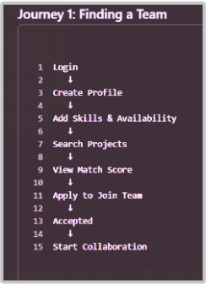
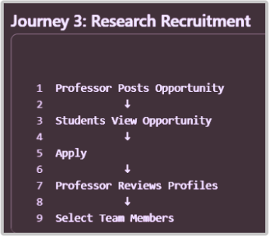
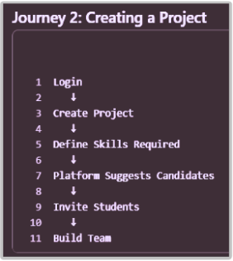
user
MANUAL
9
INNOV8

Slide 10


Innovation and Uniqueness
SKILL
COMPATIBILITY SCORE
ONE CONNECTED
ECOSYSTEM
VERIFIED
STUDENT PROFILES
Provides a percentage-
based match between
students skills and
opportunities
requirements
TWO-WAY
DISCOVERY
Clubs and projects stay
independent, connected
through students, skills
and interests.
Institutional verification
creates trusted profiles
with skills, interests and
achievements
Students find relevant opportunities
Clubs/Projects find
suitable talent
10
INNOV8

Slide 11

What We Will Build
✅ Student Profiles
Skills & Interests
Availability Experience & Preferred Roles
✅ Talent Discovery
Search Students by Skills
Explore Potential Teammates
✅ Smart Match Score
Compatibility Percentage
Team Recommendations
✅ Team Formation
Create Teams
Join Teams
Invite Members
✅ Projects & Research Hub
Create Project Listings
Apply to Opportunities
✅ Communication
Basic Team Chat
Direct Messaging
Why This MVP?
✅ Solves the core problem
✅ Demonstrates team formation workflow
✅ Realistic to build during a hackathon
✅ Provides immediate value to students
MVP
PITCH
·
💡 Our MVP focuses on one goal: helping students discover the right teammates and form effective teams quickly and efficiently.
11
MVP-Minimum Viable Product
INNOV8

Slide 12

📈
👨‍🎓 Students
Find the right teammates faster
Access more projects, hackathons, and research opportunities
Build stronger professional networks
Gain hands-on experience through collaboration
👨‍🏫 Professors & Mentors
Discover students with relevant skills more easily
Build project and research teams faster
Improve student participation in research initiatives
IMPACTS
🏫 Institution
Better utilization of student talent
Increased participation in hackathons and research programs
Stronger culture of innovation and cross-department collaboration
7
8
12
INNOV8

Slide 13




Conclusion
Why Our Platform?
Connects students based on skills, interests, and availability
Simplifies team formation for projects, hackathons, and research
Helps professors discover and recruit talented students
Creates a collaborative and opportunity-driven campus environment
Our Solution Delivers
✅ Smart Talent Discovery
✅ Intelligent Match Scoring
✅ Efficient Team Formation
✅ Research & Project Collaboration
✅ Unified Student Ecosystem
Empowering students to connect, collaborate, and innovate by bringing talent, opportunities, and teamwork into one unified platform.
13
INNOV8

Slide 14


Meet the Team
Saloni Bhanwar
Nishita Lumini
Behura Kavyanjali
Nishita Shankar
Rishabh Nagvekar
Krishay G
14
INNOV8

Slide 15

THANK YOU!
15

